Slide 1
Outcomes & Assessment
Assessing Student Learning to Support Continuous Improvement and Accreditation An introduction for the New Faculty Academy, Summer 2020 Gail Niklason (gniklason@weber.edu), Office of Institutional Effectiveness

Slide 2
Session Outcomes
As a result of this session, you should be able to:
Describe the instructor’s role in program and institutional assessment
Identify the program outcomes for the program in which you are teaching
Use a curriculum grid to determine the program outcomes your courses address
Use an outcome/assessment alignment worksheet as a framework of course design
Collect, analyze, and respond to assessment data for purposes of reporting and continuous improvement
Become aware of tools within Canvas and Chi Tester to support data collection

Slide 3
Levels of assessment
Course-level
Assessment, reflection, discussion – which informs:
Department/Program-level
External accreditation (ABET, ACEN, NASD, etc.) and/or internal processes driven by the Utah System of Higher Education – which informs:
Institutional-level
Northwest Council on Colleges and Universities – NWCCU
We have just begun writing the self-study for our Year 7 accreditation visit, which will occur in the fall of 2021.
Where do you have an impact?
Notes:
I hope you can see that your impact is far-reaching and goes beyond your immediate classroom.

Slide 4
Assessment – everyone’s favorite word!
While assessment is driven by our accreditation processes, it is critical for determining the extent to which our students are achieving program outcomes.
Accountability and improvement
Program outcomes are developed by the program faculty and identify the skills, knowledge, and attitudes students will develop as they move through their academic programs.
Some examples from the recently revised accreditation standards:
1.C.2 The institution awards credit, degrees, certificates, or credentials for programs that are based upon student learning and learning outcomes that offer an appropriate breadth, depth, sequencing, and synthesis of learning.
1.C.5 The institution engages in an effective system of assessment to evaluate the quality of learning in its programs. The institution recognizes the central role of faculty to establish curricula, assess student learning, and improve instructional programs.
Notes:
This has become a key aspect of our regional accreditation process. Revised standards went into place in January of 2020 and several of them specifically address the role of faculty in identifying and assessing student learning outcomes, at both the program and the institutional level. For additional information, please see https://www.nwccu.org/accreditation/standards-policies/standards/

Slide 5
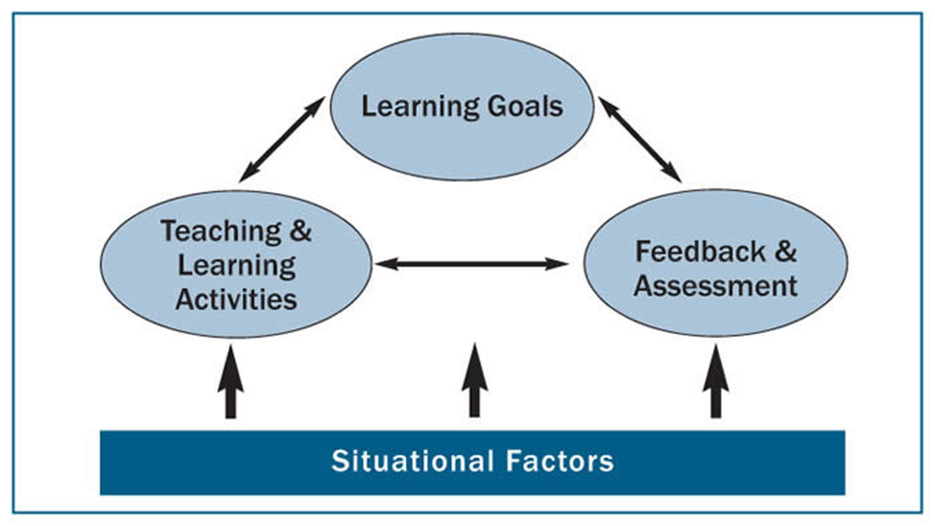
An Integrated Course Design Approach
COVID!
Fink, L.D., (2013). Creating Significant Learning Experiences. Jossey-Bass, San Francisco, CA.
Notes:
I like this graphic because it so well represents the iterative process that teaching is. Each aspect informs and is informed by the other. And then there are all the situational factors that come up…. Like….. Assessment is a part of a bigger picture, but too often it’s an afterthought.

Slide 6
Course Design – three approaches
A typical response to the challenge of prepping a new course is to ask yourself “what do I want to cover?”
How does that look in the courses you teach?
A second option is to ask yourself “what activities do I want to include in the class?”
Maybe I’ll lecture about 2/3 of the time, provide case studies for 1/6 of the time, and conduct simulations the final 1/6 of the time.
How does course design differ when you ask yourself “what are the course outcomes my students need to master?”
This is the process of ‘backward design’.
Step 1 – determine what your students need to know or do by the end of the course
Step 2 – consider the type of assessment that will provide you with evidence of mastery
Step 3 – design your classroom strategies and learning activities
Are you aware of the outcomes that your course(s) should cover?
Notes:
Understanding by Design, Grant Wiggins and Jay McTighe, 1998

Slide 7
Program and Area Outcomes
A curriculum map provides a visual alignment between instruction with desired program competencies
Find your program’s outcomes
http://Weber.edu/ie – select ‘Department Assessment Results’, then select your college and department on the subsequent pages
When your department or program page is displayed, locate and open the ‘learning outcomes’ accordion.
Course level outcomes
On that same page select and open the ‘curriculum grid’ accordion.
General Education outcomes
http://weber.edu/gened
Notes:
https://www.weber.edu/ie/Results/Department_Results.html
Give participants time to find their program outcomes and curriculum grid

Slide 8
Align Outcomes
Identify the program-level outcome
Articulate the course-level outcome(s) that aligns with the program-level outcome
What will students know, value, and be able to do by the end of the course?
Determine, then design assessment methods
What assessment methods will provide evidence that students have achieved the course outcome? How will feedback be given to students regarding their achievement of the outcomes? What assessment methods will help to inform and improve student progress toward achievement of the outcome(s)?
Design learning experiences
What learning experiences will students actively engage in as they progress towards this learning outcome? What learning activities will support students in their ability to achieve the course outcomes? What activities will prepare your students to succeed on your designated assessments?
Notes:
A program outcome will be addressed at multiple points within your curriculum; the course-level outcomes that align with the program outcome will vary with the course and will likely become more sophisticated as students progress through the program. For example, a program outcome around ‘problem-solving skills’ will have an aligned course-level outcome in Physics 2210 that may be very different from the course-level outcome in Physics 4610.

Slide 9
Design Assessment
Formative versus summative assessment
Formative assessment is characterized by:
Quick feedback
Low stakes
Repeated opportunity to master
Advances learning
Activates students as the owners of their own learning
Informs instruction
Summative assessment is characterized by:
Delayed or no feedback (i.e., final exam)
High stakes
An audit of skill mastery
Assessment data is collected from summative experiences

Slide 10
Aligning Outcomes, Activities, and Assessment
Notes:
Using Bloom’s Taxonomy to Align Assessment:
http://louisville.edu/delphi/resources/-/files/resources/pages/Blooms-Taxonomy-Handout.pdf

Slide 11
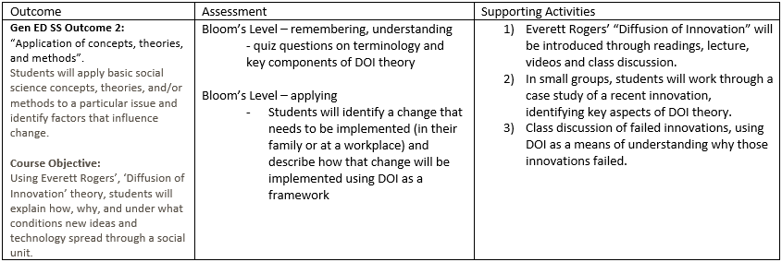
Alignment example:

Slide 12
Match the assessment to the learning goal
If the learning goal is ‘knowledge & conceptual understanding’ use scores on objective tests created with test blueprints that map questions to course outcomes.
If the learning goal is ‘thinking & performance skills’ use various learning activities (papers, projects, performances, portfolios, etc.) that are assessed with rubrics.
If the learning goal is ‘attitudes & values’ use reflective writing that is assessed with a qualitative analysis.
Attribution: Linda Suskie; Higher Education Assessment Consultant – June 2019

Slide 13
Gathering, Interpreting, and Reporting
Your course activities generate a lot of data… do you need to collect and report on all of it?
NO!
Identify one or two key assessment activities that demonstrate learning of each outcome.
See previous slide
Provide at least one measure of direct evidence
Can be augmented with indirect evidence
Wait, aren’t grades enough evidence?
No…don’t provide meaningful information on strengths and areas for improvement; sometimes include extraneous factors; useful but insufficient evidence.
Notes:
Define direct and indirect evidence

Slide 14
Wait – I grade all the time…. Isn’t that assessment?
In short, sometimes.
Grading is critical – students need ongoing, regular feedback on their work. Grades are the currency of academia. Grades often contain ‘extras’ that do not relate directly to an outcome.
Do you deduct points for a late assignment? Is that ‘skill’ part of the outcome?
Grades inform the student; assessment informs the instructor and the program faculty.
Are students achieving outcomes at a satisfactory level?
At the aggregate, are at least 80% of students achieving at a rate of 70% or higher?
If not, what actions might the instructor take for improvement?
Remember, the students may not be the issue…
Notes:
Grading vs Assessment of Learning Outcomes: What’s the Difference? https://www.westga.edu/administration/vpaa/iea/assets/docs/grading_vs_assessment_of_learning_outcomes_whats_the_difference.pdf
NWCCU 2020 Accreditation Standards: https://www.nwccu.org/accreditation/standards-policies/standards/

Slide 15
Grades vs Outcomes Illustrated
Scenario
You have created an assignment for which students will submit an artifact.
Your assignment addresses two program-level outcomes, and two additional, assignment-specific outcomes, each worth 10 points for a 40 point assignment.
Your expectation (threshold) is that at least 80% of your students will meet or exceed a score of 70% or higher.
On the next slide is a summary of your students’ results.

Slide 16
Name | Criteria 1 (pgm outcome 1) | Criteria 2 (pgm outcome 2) | Criteria 3 (assign specific) | Criteria 4 (assign specific) | score | percent | grade
Student A | 9 | 6 | 8 | 9 | 32 | 80.00% | B-
Student B | 8 | 4 | 7 | 8 | 27 | 67.50% | D+
Student C | 6 | 3 | 5 | 9 | 23 | 57.50% | E
Student D | 10 | 8 | 9 | 10 | 37 | 92.50% | A
Student E | 8 | 5 | 10 | 10 | 33 | 82.50% | B
Student F | 7 | 4 | 10 | 10 | 31 | 77.50% | C+
Student G | 4 | 3 | 7 | 6 | 20 | 50.00% | E
Student H | 10 | 6 | 6 | 7 | 29 | 72.50% | C-
Student I | 10 | 8 | 9 | 9 | 36 | 90.00% | A-
Student J | 9 | 4 | 8 | 10 | 31 | 77.50% | C+
Student K | 7 | 6 | 8 | 8 | 29 | 72.50% | C
Student L | 8 | 5 | 8 | 8 | 29 | 72.50% | C
Student M | 9 | 7 | 9 | 10 | 35 | 87.50% | B+
Student N | 10 | 6 | 8 | 9 | 33 | 82.50% | B
% meets/exceeds 85.71% 14.29% 85.71% 92.86% 85.71%
Overall, 12 of 14 students earned a total score of 70% or higher – success!
Notes:
Without assessment at the outcome level, it might be easy to overlook this deficiency. But wait, what if you are teaching pilots and outcome 1 is ‘takeoff’ and outcome 2 is ‘landing’. Now you have a problem. More realistically, maybe outcome 1 is using a specific analysis tool, while outcome 2 is identifying the appropriate analysis tool.
\

Slide 17
TOO MUCH?
We have tools to help…

Slide 18
Using Canvas for Assessment
Assessment can take many forms
Quizzes, written assignments, discussion postings, presentations, creative works, etc.
Scoring Rubrics
Communicate expectations for the assignment
Allows students to self-assess prior to submission
Expedites grading
Provides more grading consistency
Canvas rubrics can include program-level outcomes (if your program has requested they be made available) as well as instructor/course level outcomes.
Rubrics are created using your own learning outcomes and/or imported outcomes

Slide 19
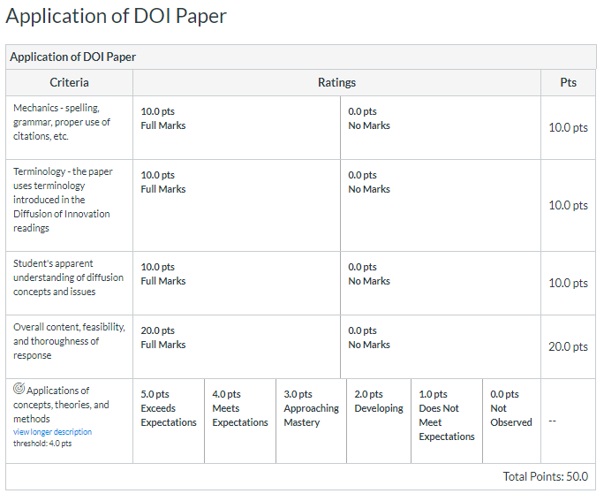
Canvas Rubric Example

Slide 20
Aligning Questions to Outcomes in Chi
The learning outcome feature in Chi Tester allows you to align individual questions to one or more program level outcomes.
All program outcomes are in Chi Tester; please see the accompanying document on how to complete the alignment and run reports.
This will also be covered in next week’s Chi Tester training.
Works with multiple choice, true/false, short-answer question types

Slide 21
And finally, reflection and action…
Data for the sake of data, is meaningless.
Without analysis or reflection, it’s just information
Compare your own results over time
Talk with colleagues teaching similar courses
Consider strategies to address low outcome measures
Implement, collect, and evaluate – the assessment cycle
Are all your students doing well?
Averages can hide problems. Are under-prepared or under-represented students performing as well as other students?
Questions?
THANK YOU!

