Slide 2
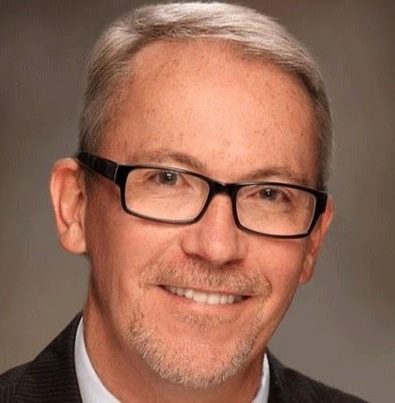
Fred Henderson NUAHEC Director
Oversees EVERYTHING!
Teaches Classroom Component

Slide 3
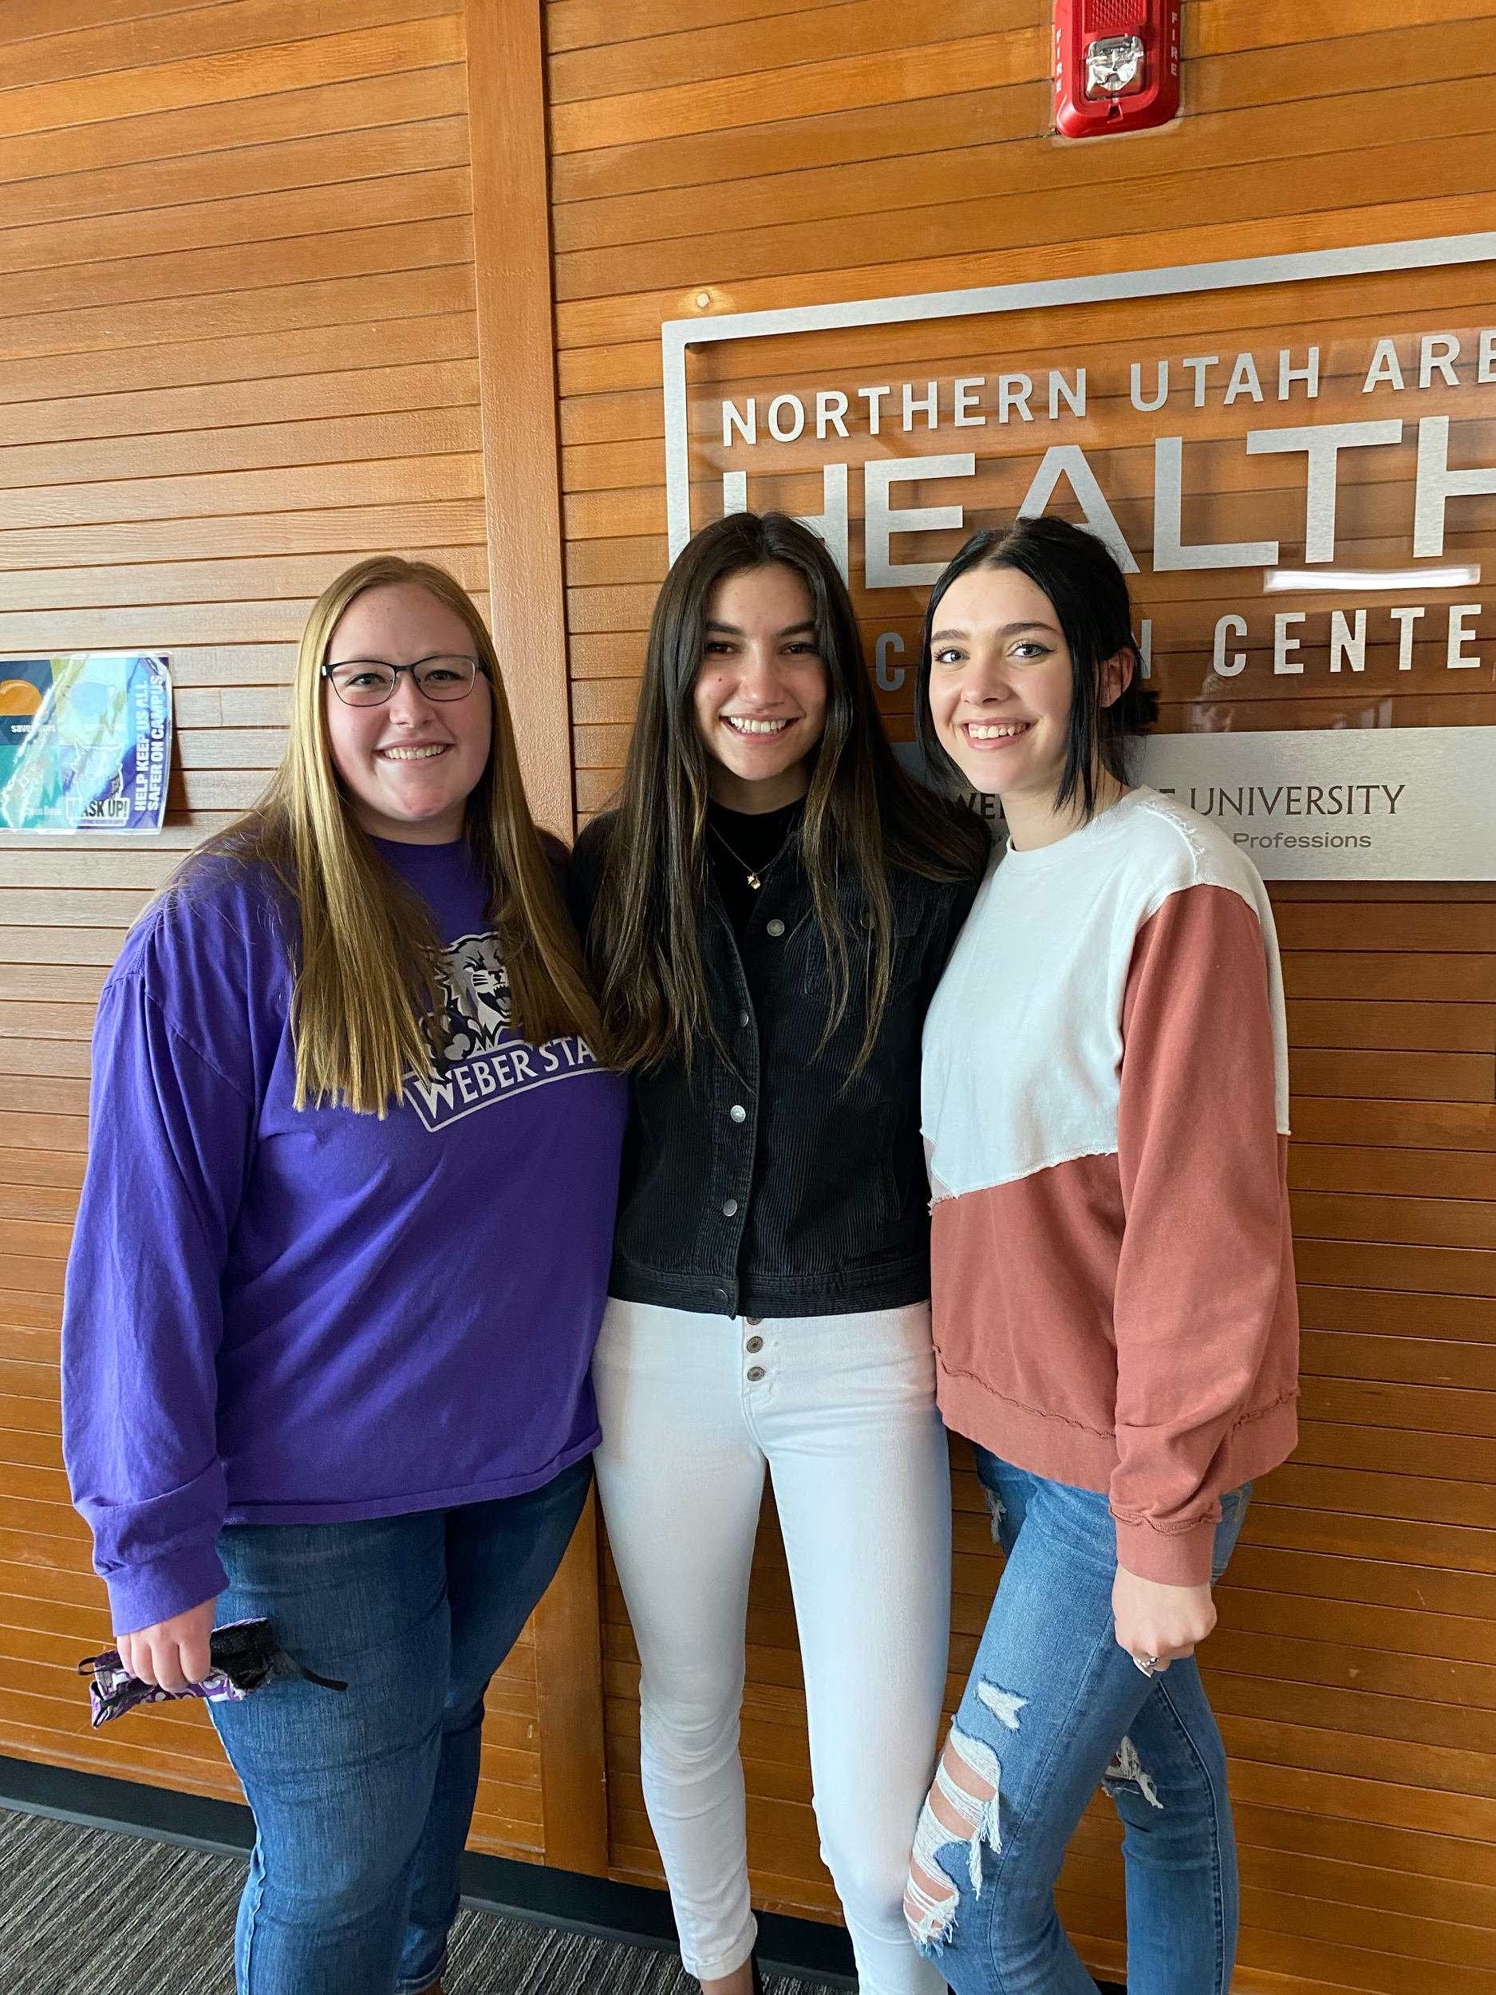
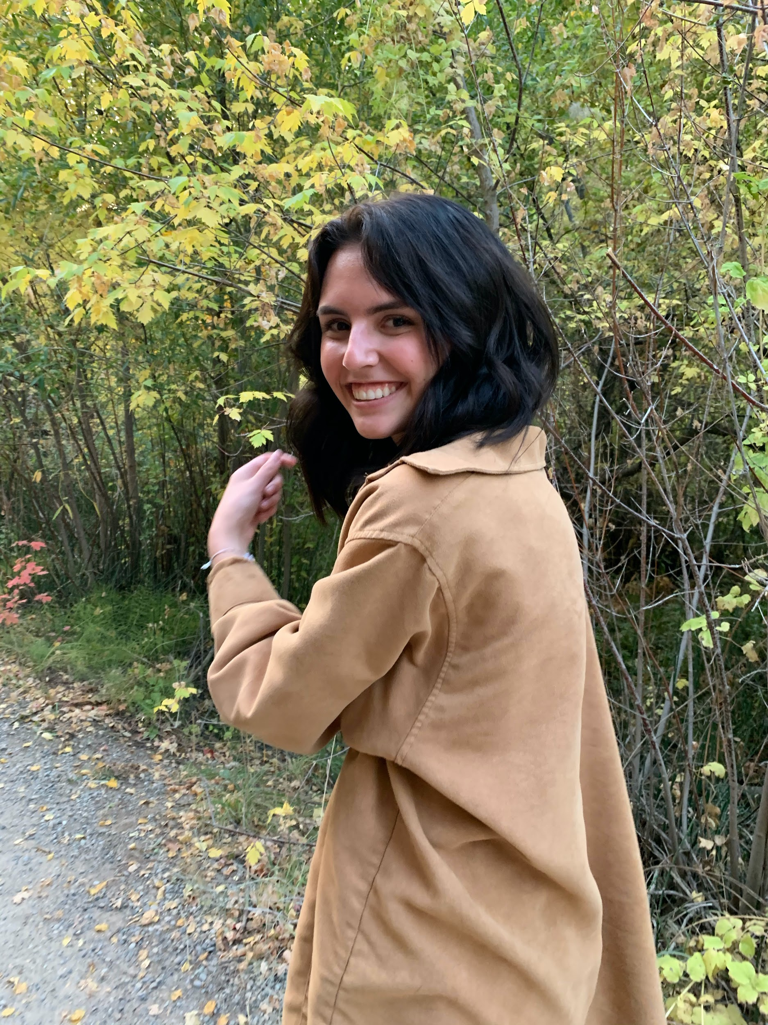
Program Managers
WSD Senior Manager: DSD Senior Manager:
Sydney Carlson Keely Brinn
Program Manager Program Manager
Madelyn Terry Aliya Newman
Technology Manager
Darren Skidmore
Aides in coordinating DSD and WSD classes
Provides office with entertainment

Slide 4
-The Elevator Pitch-
Our Vision
Work with AEC, SUAHEC, and CRAHEC
Help underserved rural and urban areas in the healthcare system
Our Mission
Help current and future scholars.
Improve
Geography
Demographic
Health Systems

Slide 5
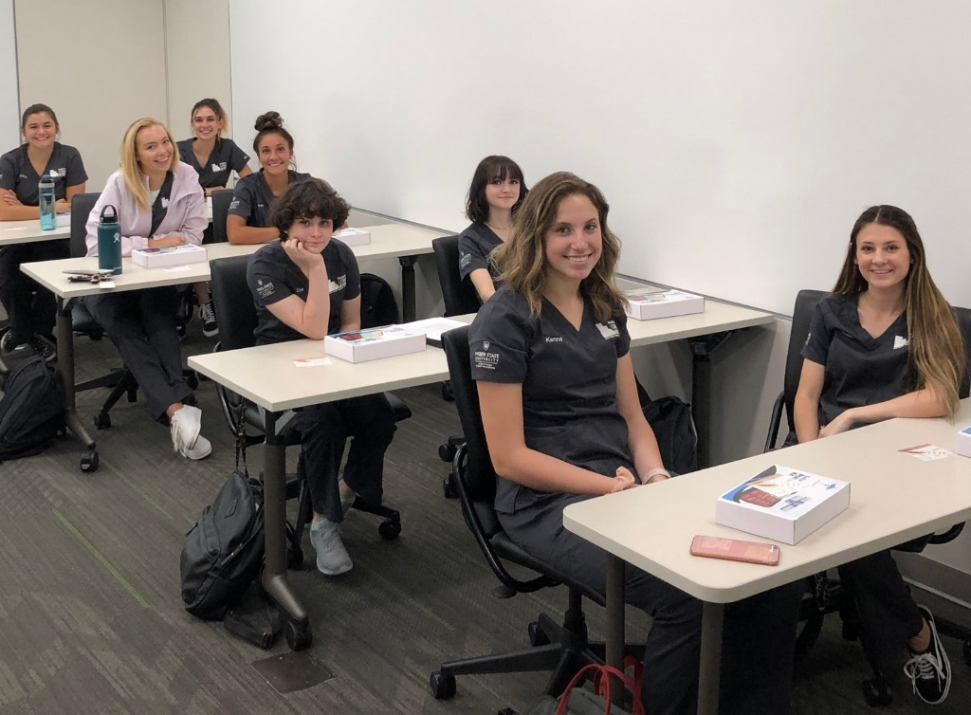
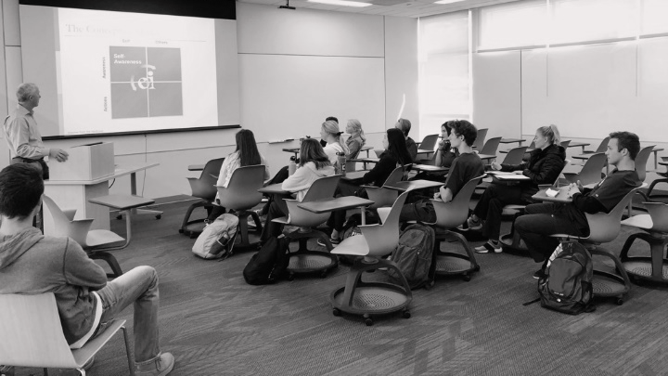
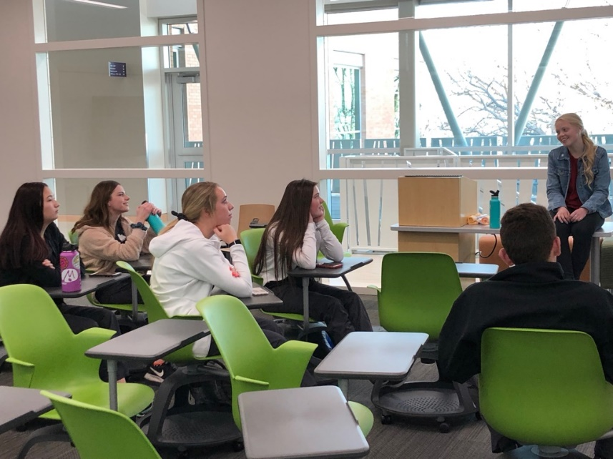
- Classroom -
HTHS 1103 Introduction to Health Careers and Care in a Diverse Society
Libs 2904
Concurrent Enrollment Credit
4 credit hours
Two class, one per semester

Slide 6
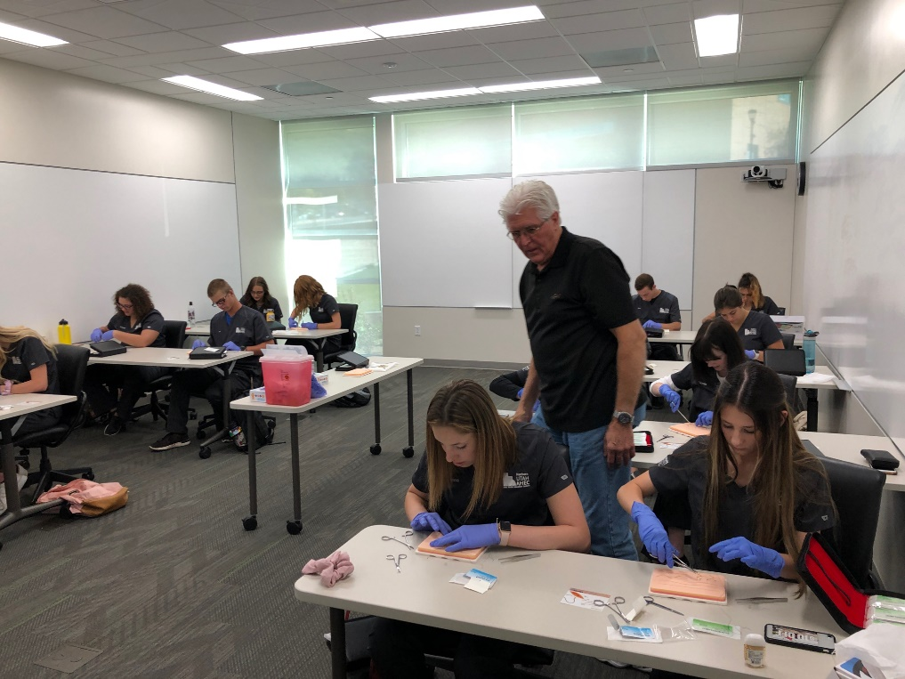
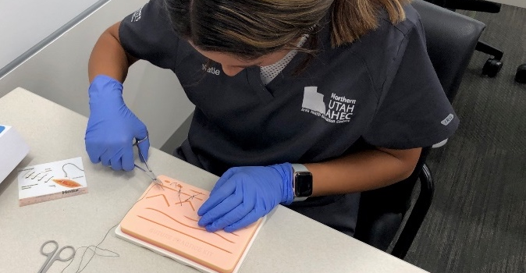
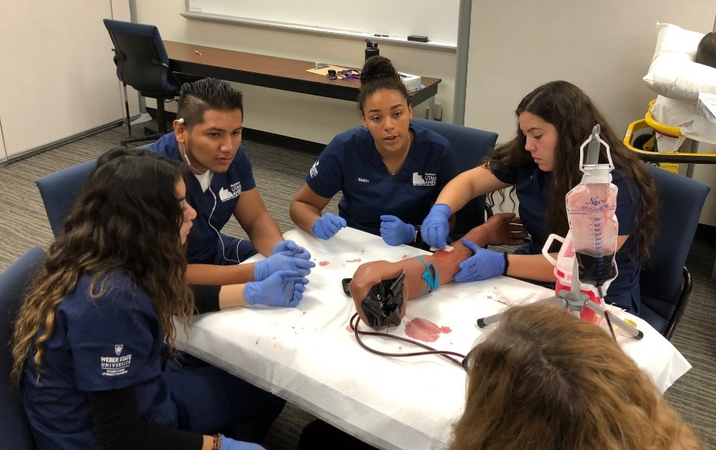
- Skills -
Vital Signs
Suturing
Intubation
IVs

Slide 7
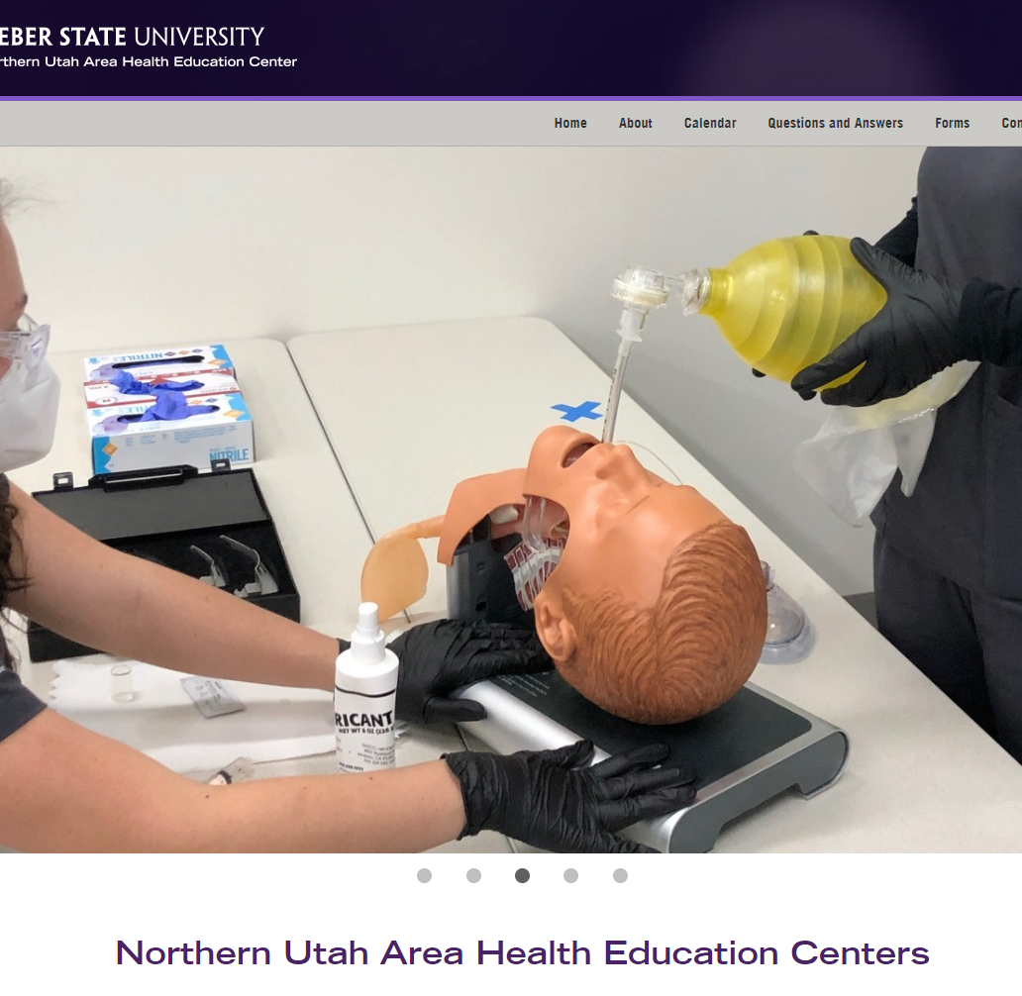
Skills Slideshow
https://weber.edu/NUAHEC
One of three random slideshows will be chosen upon loading the page!

Slide 8
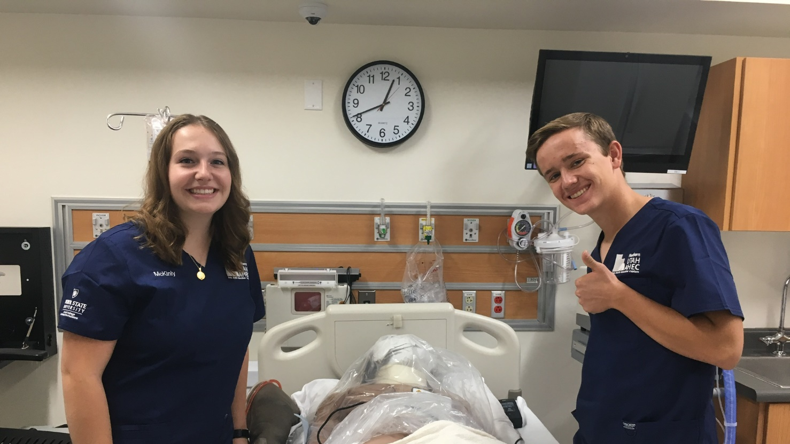
- Job Shadow-
Several Health Fields
All aspects of the clinics
Cardiology
Calton/Harrison
Endocrinology
Ear Nose Throat
General Surgery
Internal Medicine
OBGYN

Slide 9
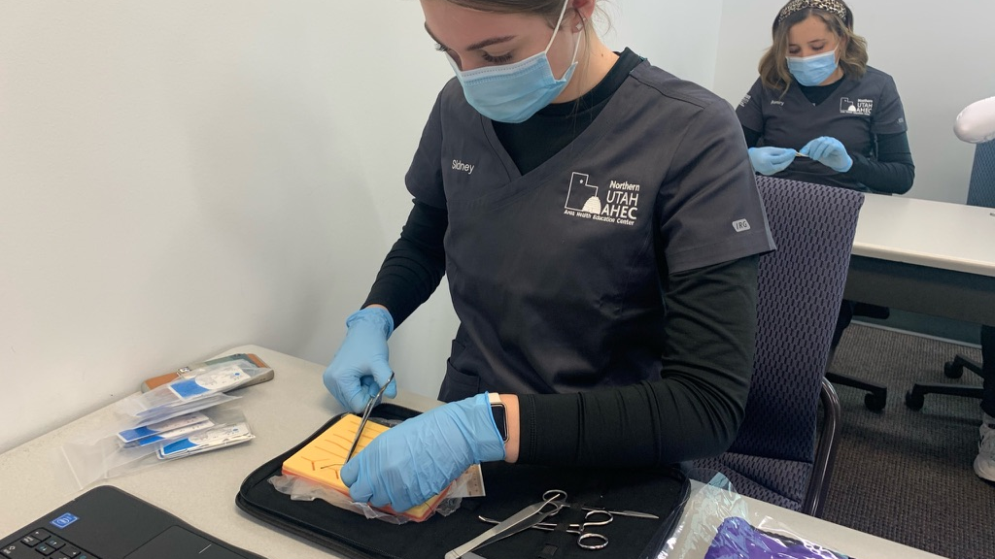
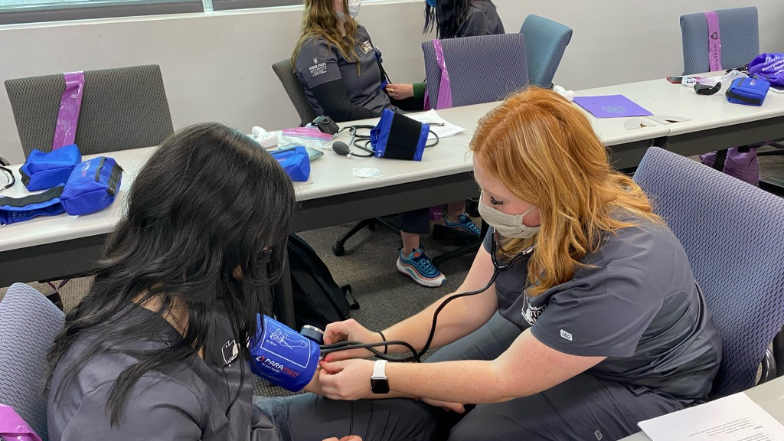
Northridge Scholars

Slide 10
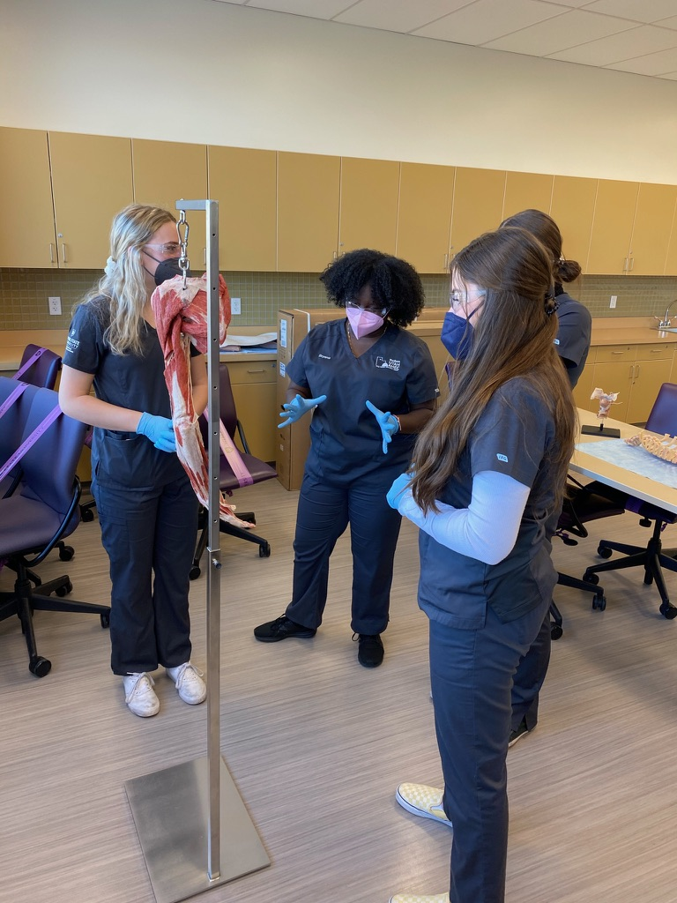
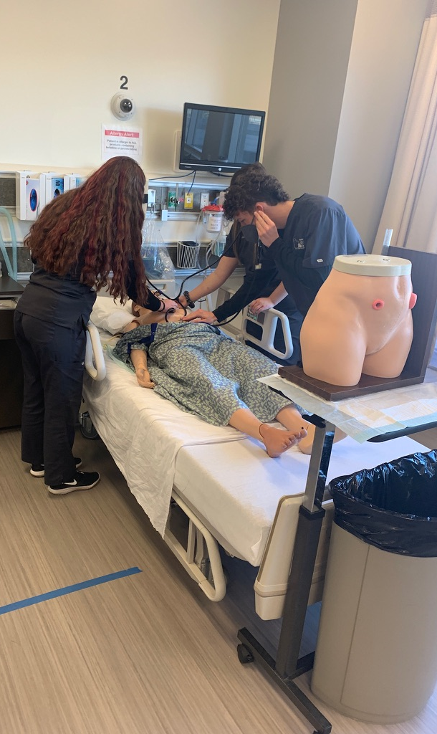
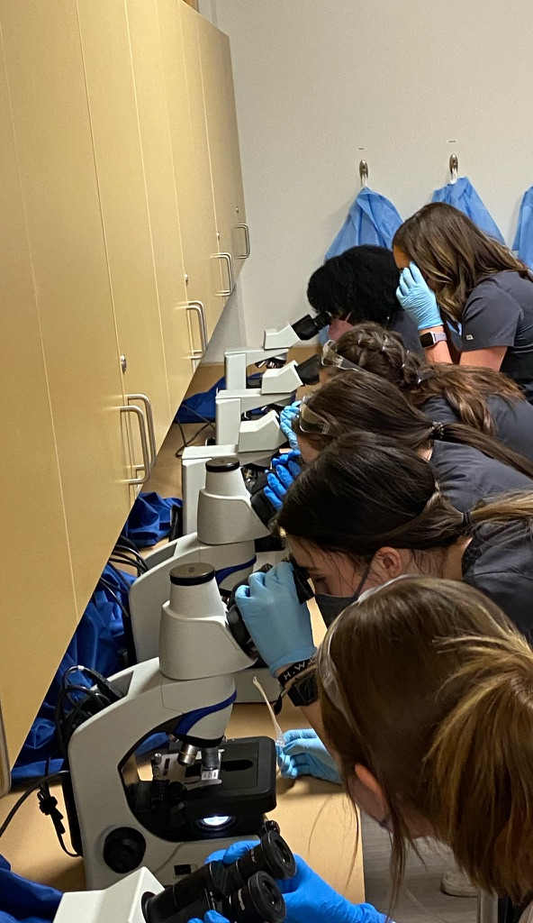
Davis Scholars

Slide 11
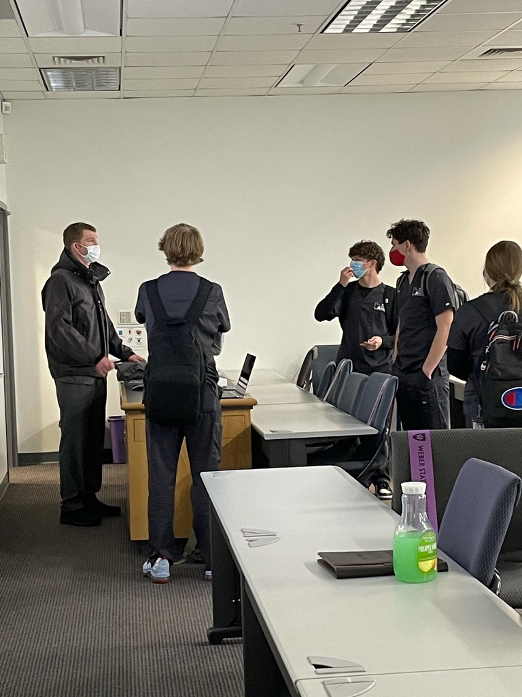
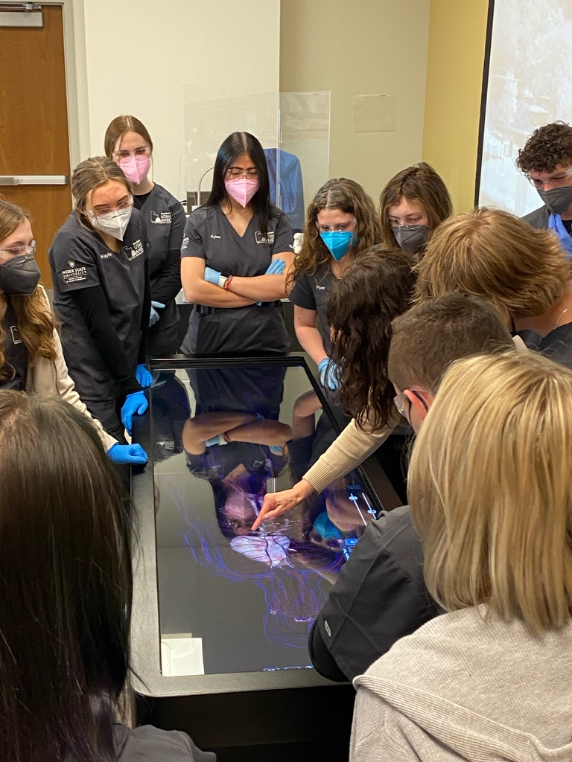
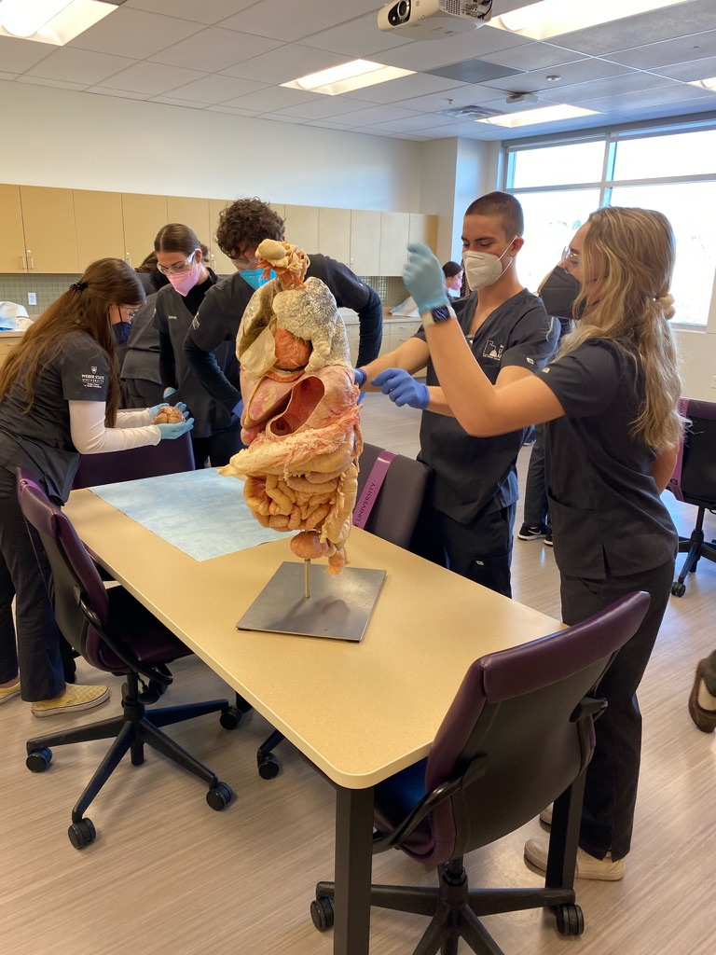
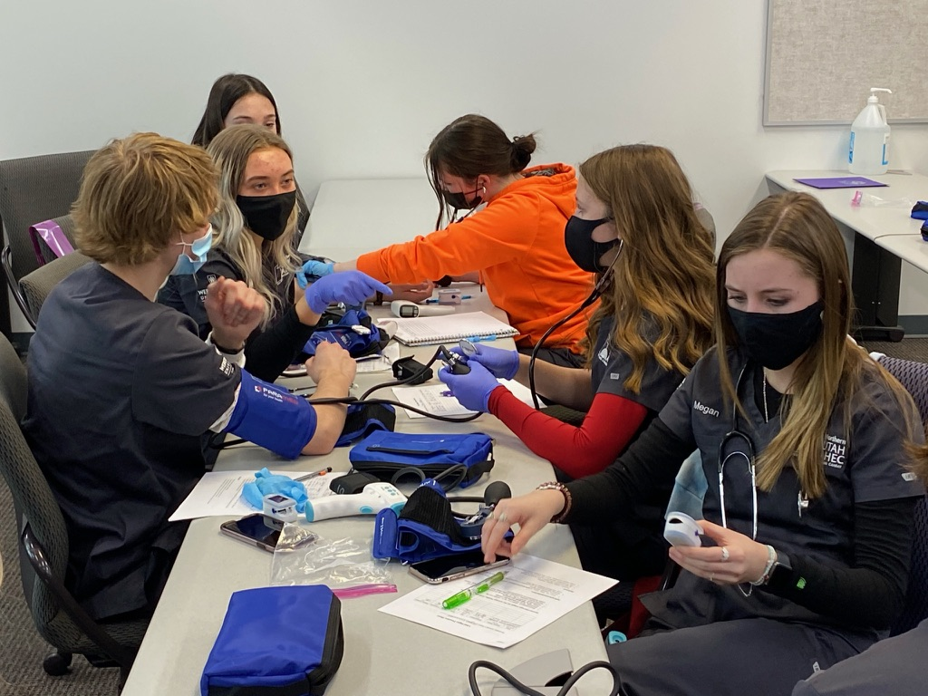
Syracuse Scholars

Slide 12
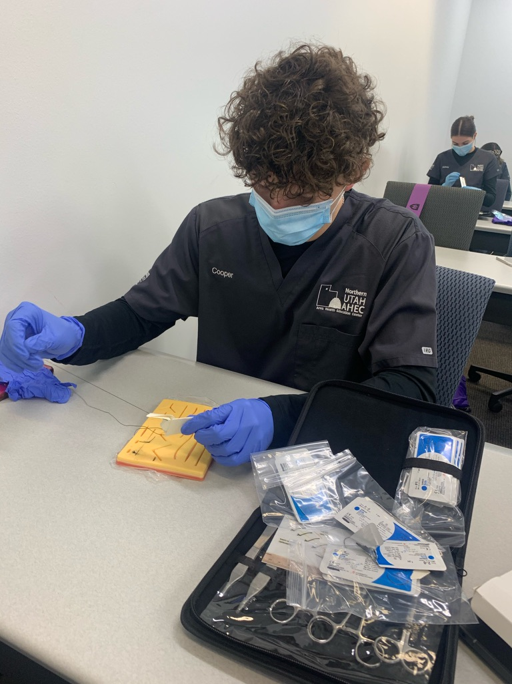
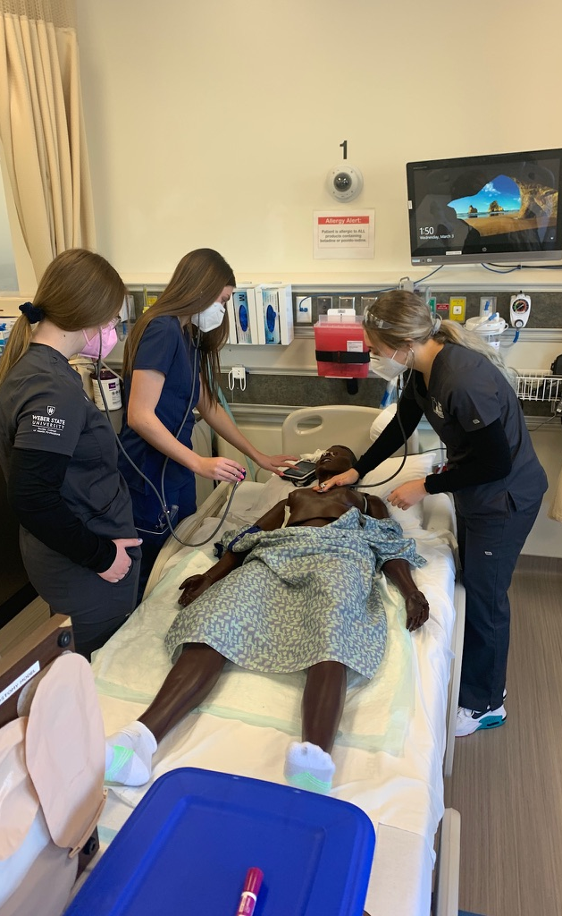
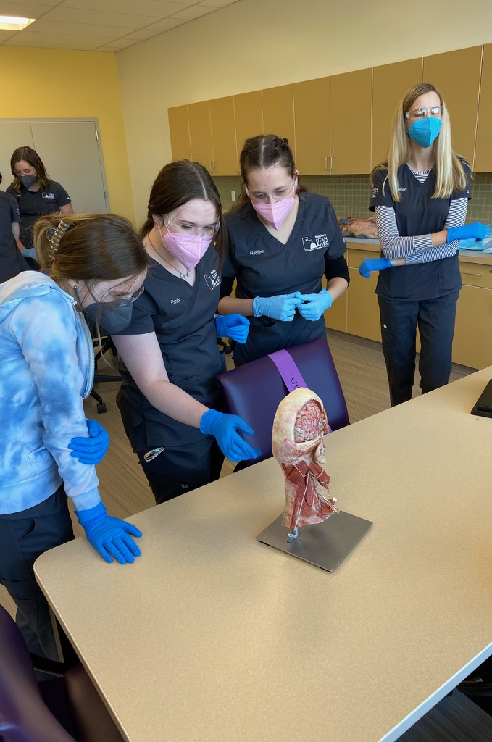
Layton Scholars

Slide 13
Scholar Testimony

Slide 14
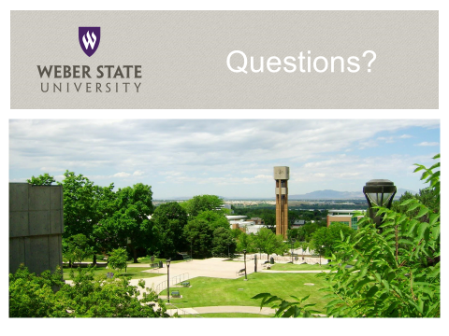
Keely Brinn- Text: (801) 425-8129 Email: keelybrinn@weber.edu
https://www.weber.edu/NUAHEC
@NUAHEC

